Slide 1
10 Visualisation Best Practices
for data storytelling
max growth

Slide 2
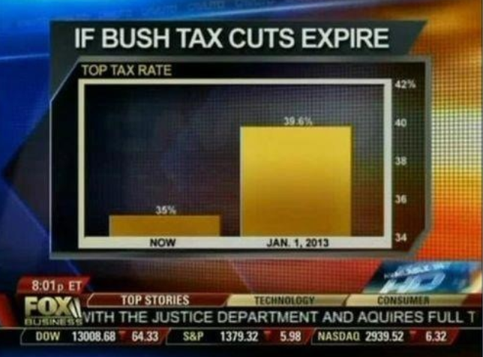
Before we get into the guidance…
Rule # 0
: don’t mislead
Notes:
Invite students to find example of misleading charts ?

Slide 3
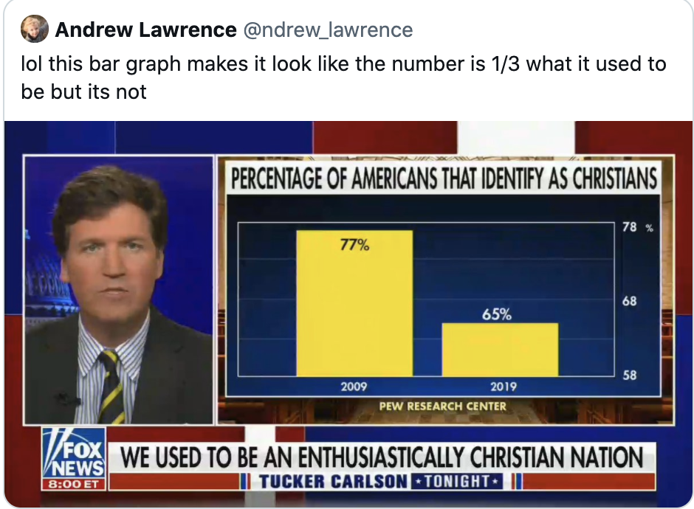

Slide 4
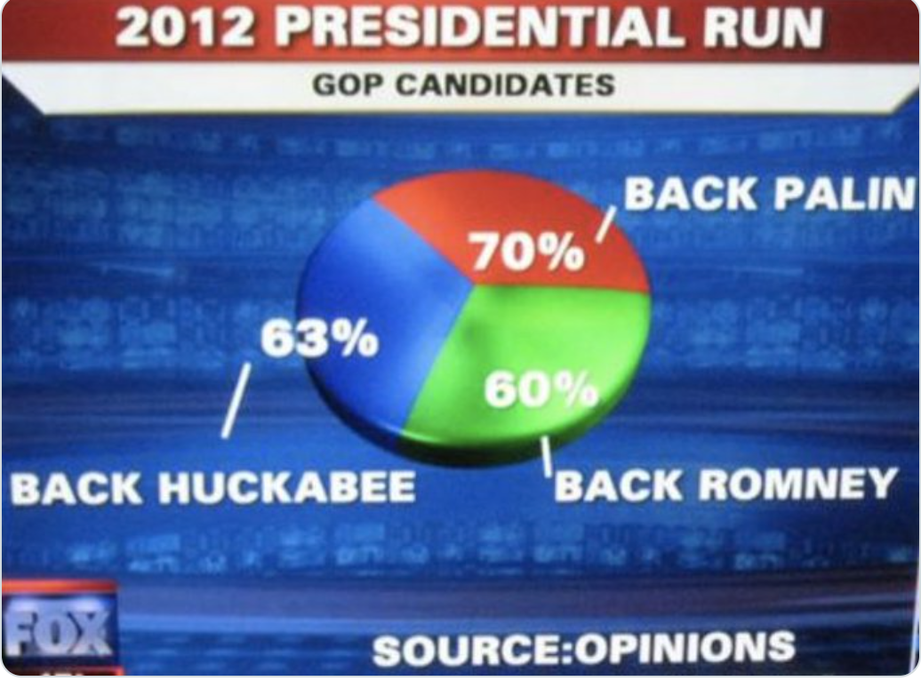

Slide 5
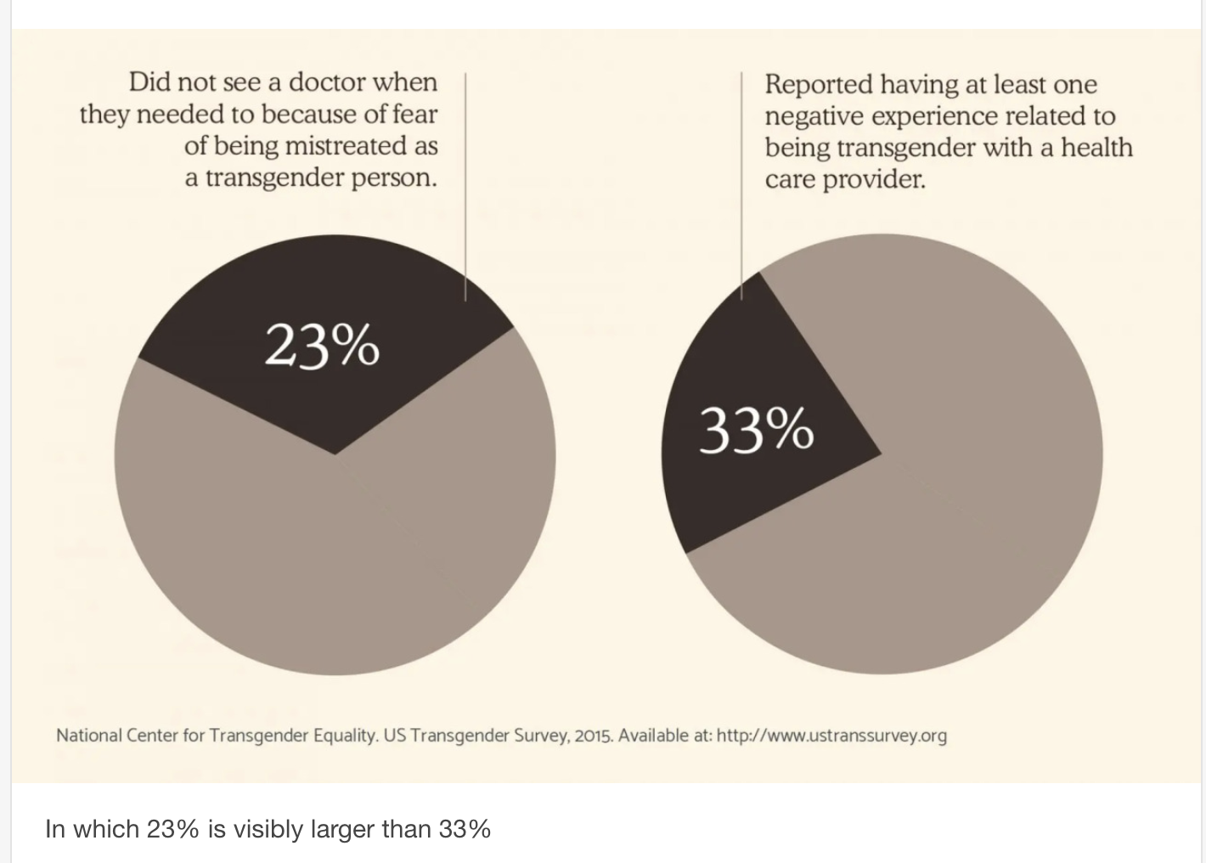

Slide 6
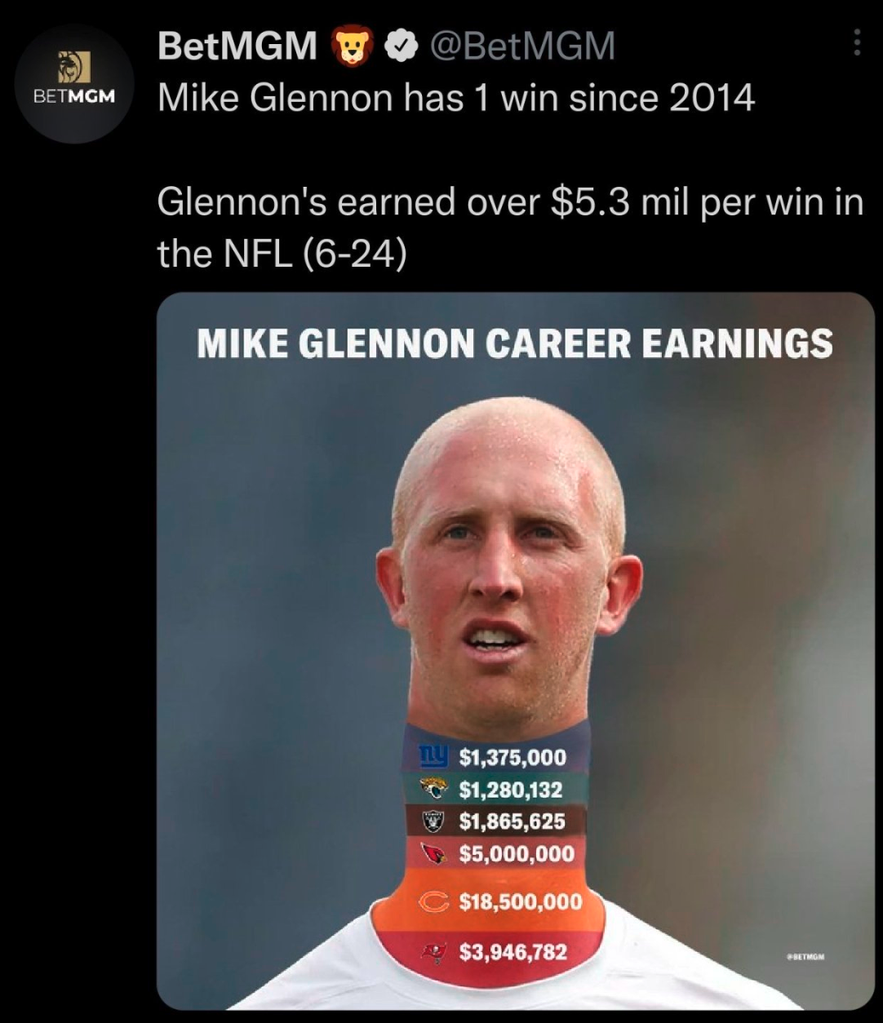
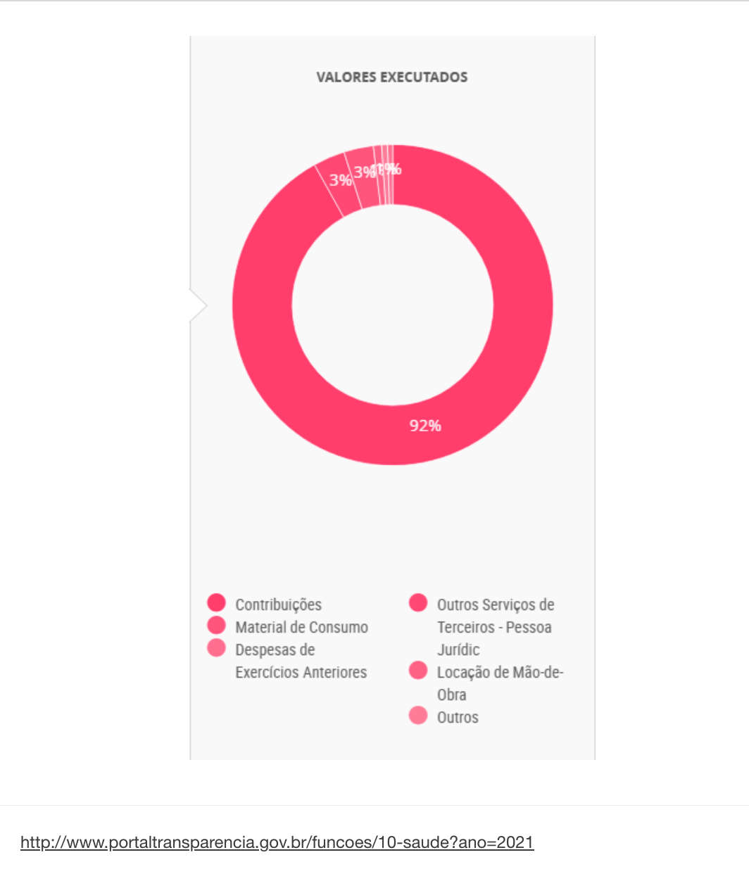

Slide 7
#1 - Choosing the right chart
A visual appropriate to the question you are seeking to answer

Slide 8

Minard's Visualization Of Napoleon's 1812 March

Slide 9
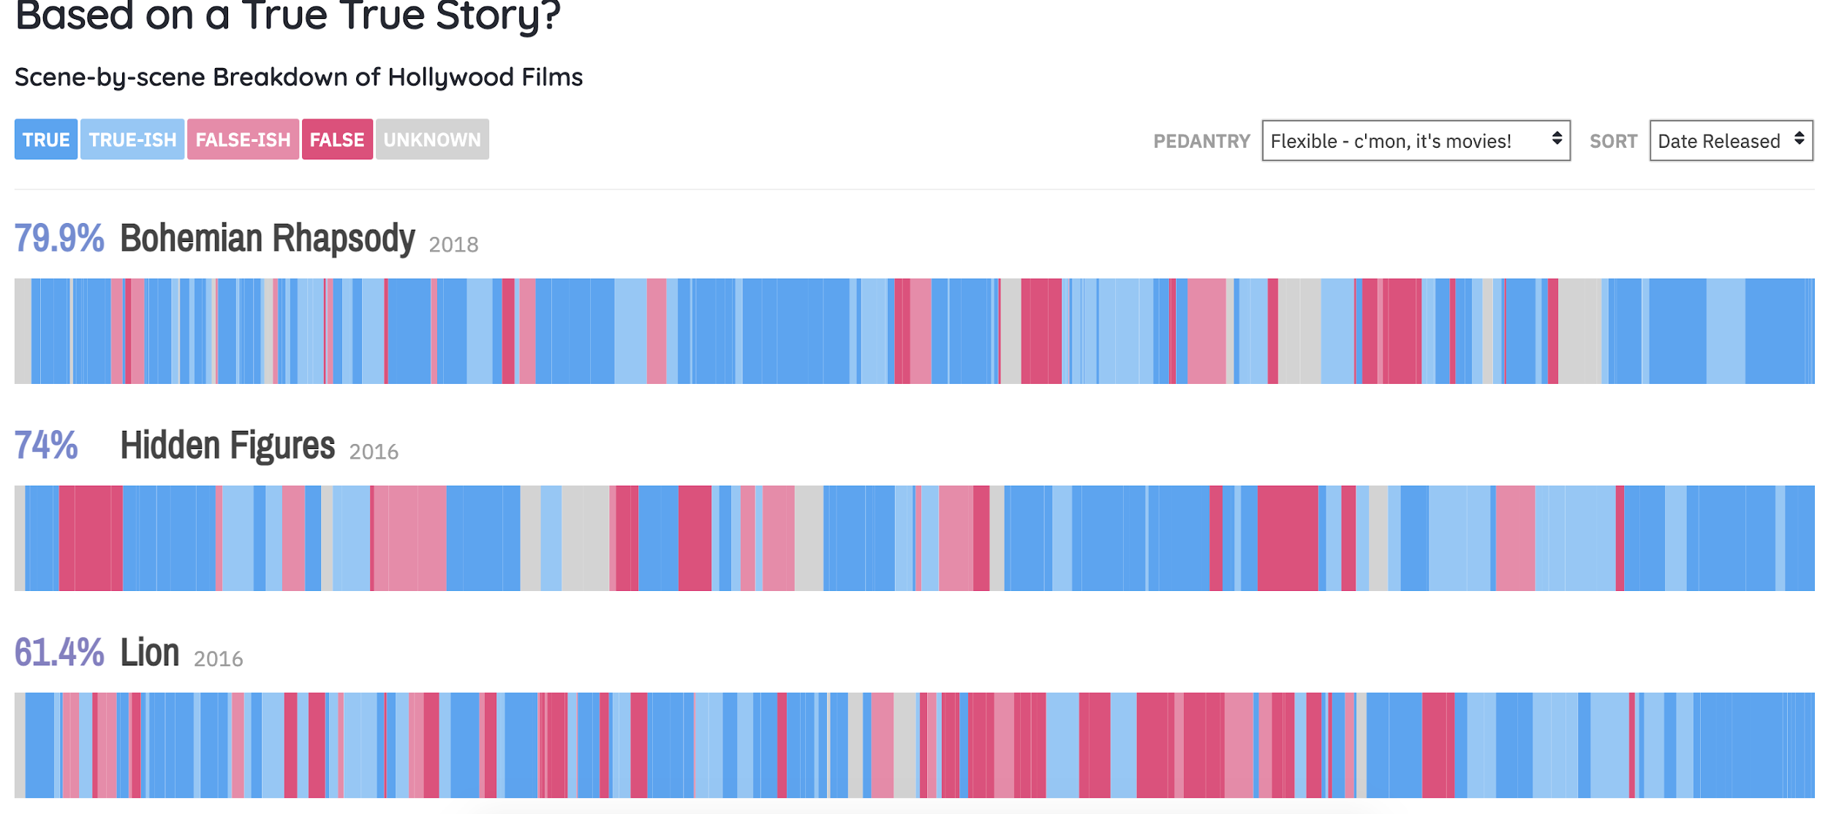
https://informationisbeautiful.net/
Notes:
Invite students to bring examples of well chosen chart types :

Slide 10
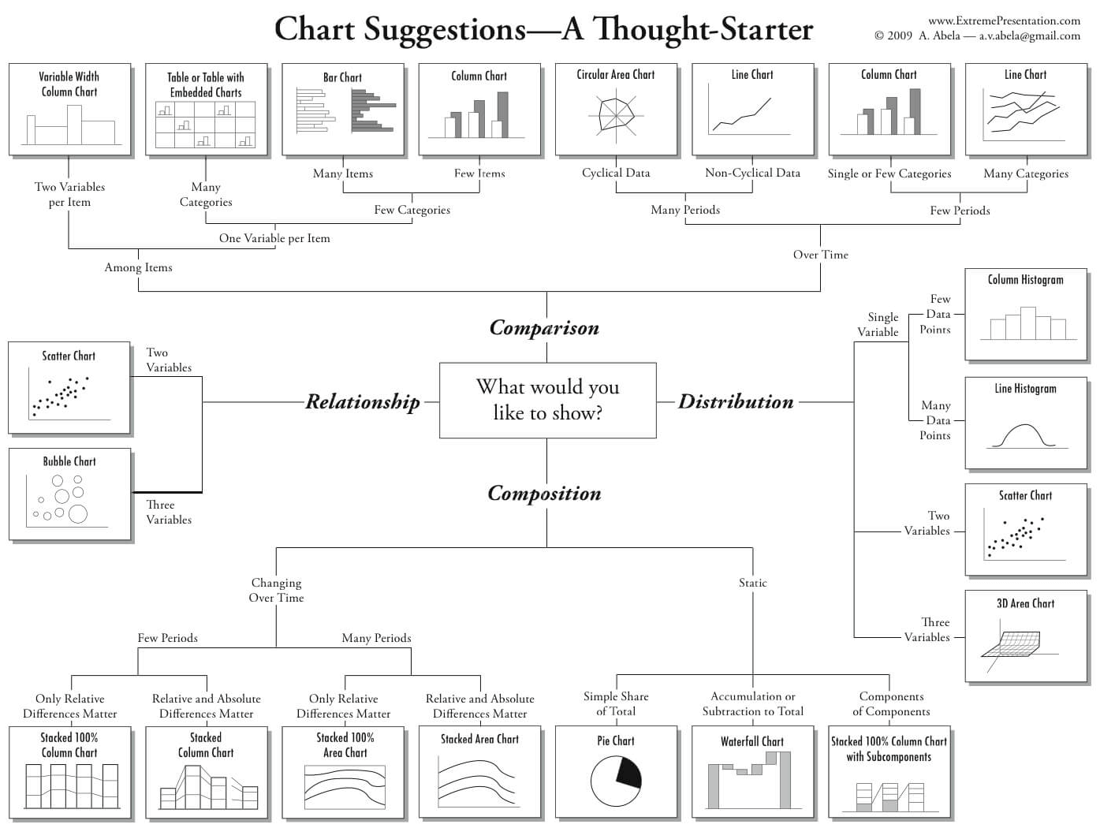

Slide 11
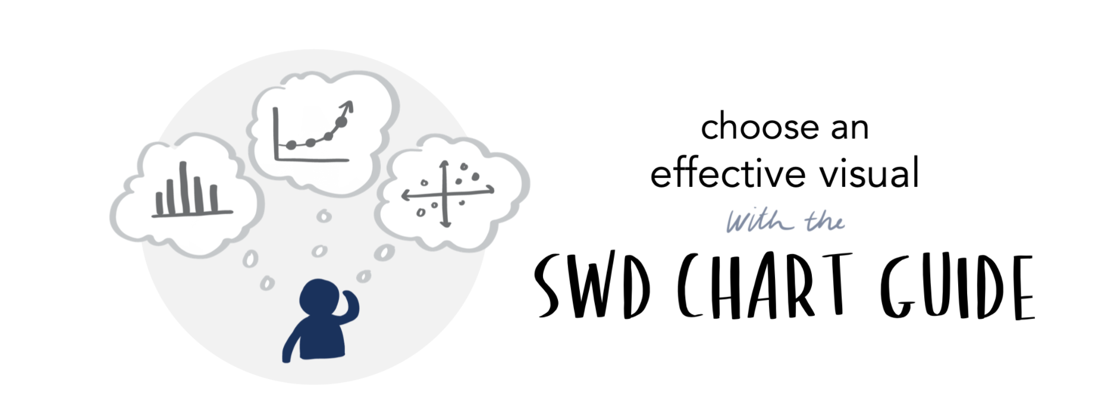
https://www.storytellingwithdata.com
Notes:
Give students scenarios - what chart should they use
Eg “are museum ticket sales affected by bad weather?”; “what percentage of orders shipped on time v shipping late?”; “does the frequency of bird strikes at various altitudes on commercial planes at uk airports follow the normal bell curve?”

Slide 12
Task 1 - pick a chart type
Given a data insight, sketch an appropriate single chart

Slide 13
#2 - engagement is key to interest
Design a product that requires intentional interaction

Slide 14
Ways to interact with charts- examples from tableau:
Dynamic filtering
Filter by one chart on another
Hover over a value
Explain data feature
See related data points
Select and apply / exclude
Sort by
Get info from the Tooltip
See a related chart in tooltip
Drill up/down to less/more detail
Choose how you want to see the view, from a parameter of options
Set actions eg proportional brushing
Notes:
Invite students to test some tableau dashboards for interactivity and rate what they liked

Slide 15
#3 - sizing
Use the most of your report real estate

Slide 16
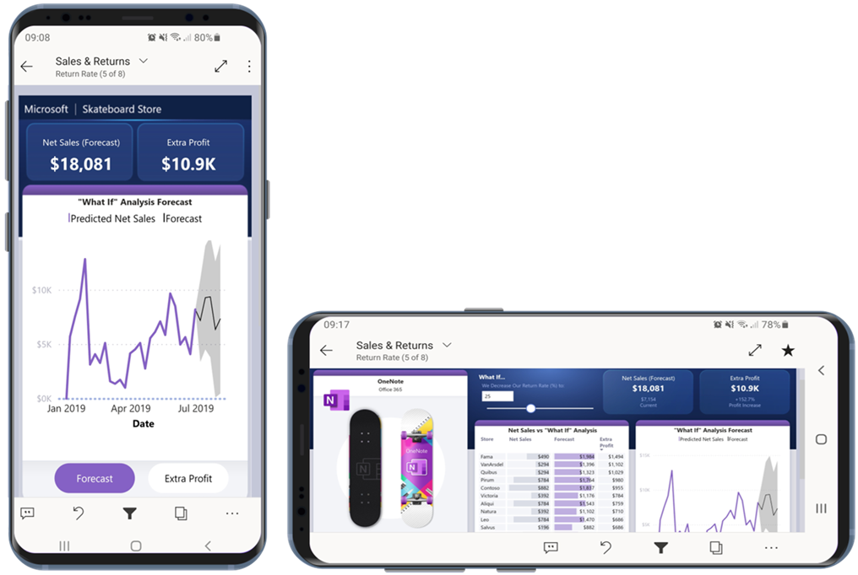
Design for the eventual device

Slide 17
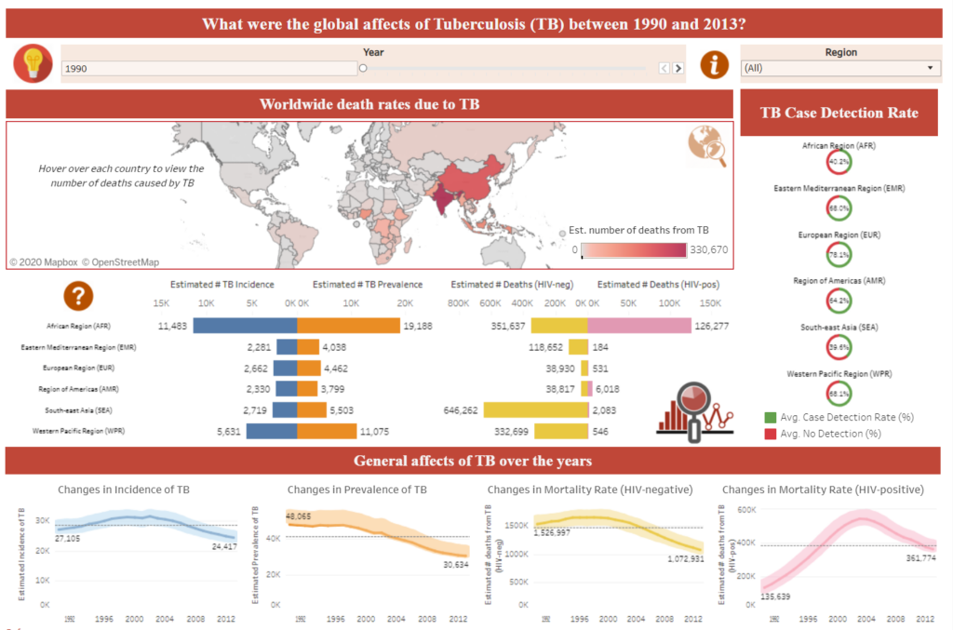
Don’t overstuff the screen

Slide 18
#4 - what do people see
Your eyes naturally go to a place. Put the important things there.

Slide 19
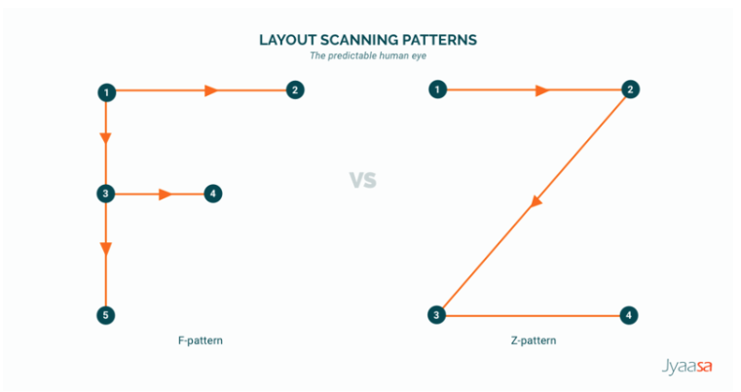
We all read information in predictable patterns

Slide 20
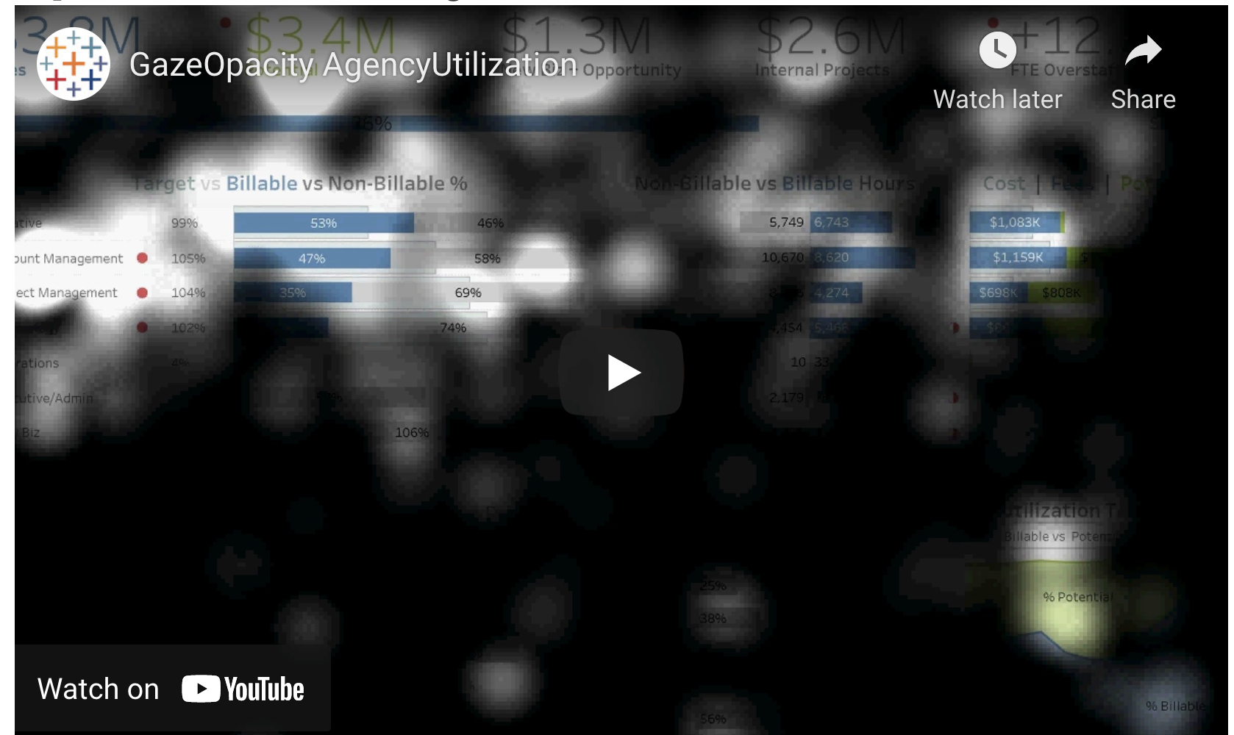
Eye tracking tells us what people pay attention to

Slide 21
#5 - what do people remember
We can only hold a limited number of items in our working memory

Slide 22
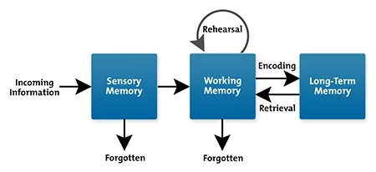
How memory works (1)
Test: do I need to remember this?

Slide 23
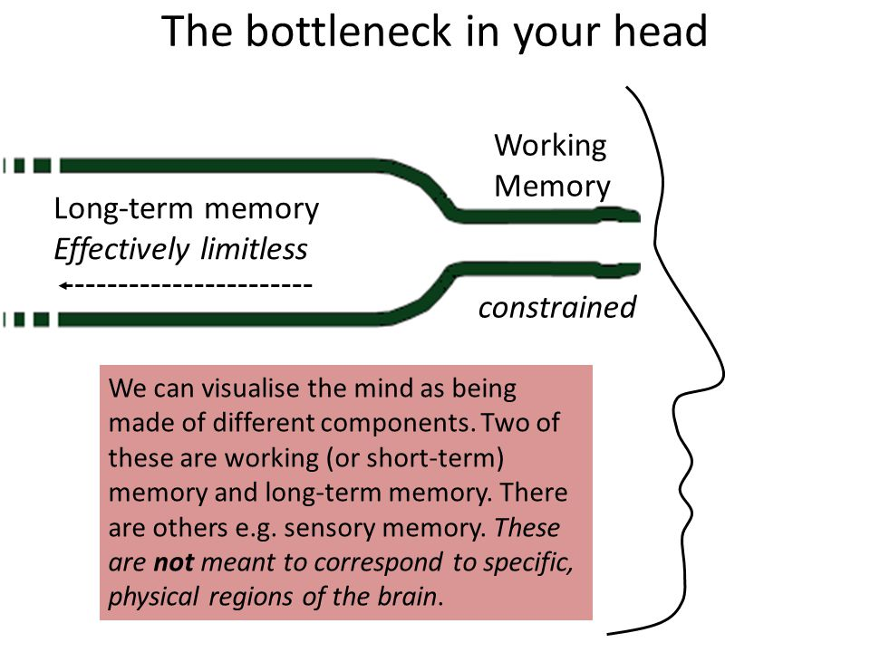
How memory works (2)
Notes:
Working memory is often described as a bottle neck - scientists have discovered that average humans can hold between 8 and 12 items in our working memory at any one time - obv this decreases with age

Slide 24
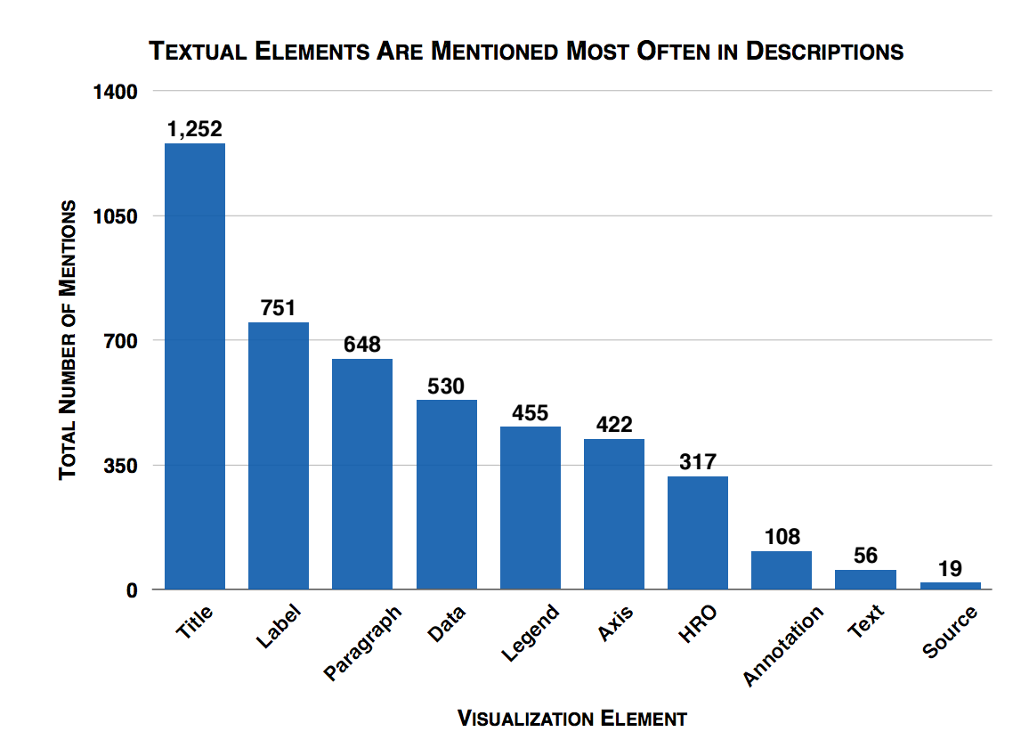
Protect what will most likely be remembered

Slide 25
#6 - cognitive overload
Make use of pre attentive attributes (but don’t overdo it)

Slide 26
Task 2 - pre-attentive processing
Experiment with different target detection attempts for colour, shape, colour+shape - tell the class at what point you became less efficient at detecting the shapes - here

Slide 27
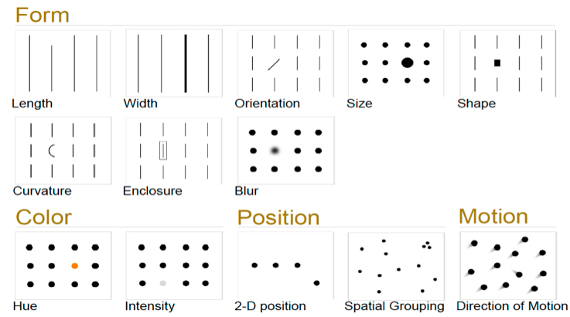
Pre attentive attributes
Notes:
A preattentive visual property is one which is processed in spatial memory without our conscious action. In essence it takes less than 500 milliseconds for the eye and the brain to process a preattentive property of any image.

Slide 28
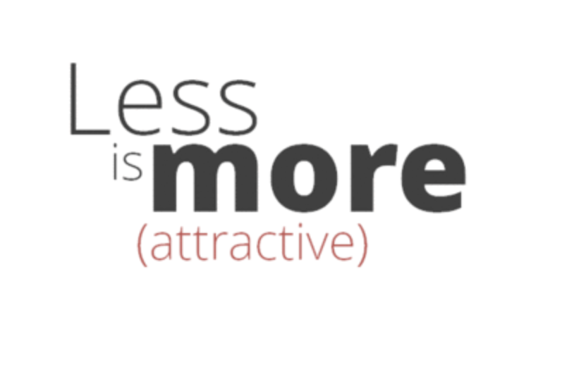
Avoid cognitive overload
1 message at a time
Simplify if possible
Never go 3D

Slide 29
#7 - be careful with colours
Colours should be appropriate, not reused, not overwhelming, preferably complementary and/or meaningful

Slide 30

Colours have meaning- and it varies by culture

Slide 31
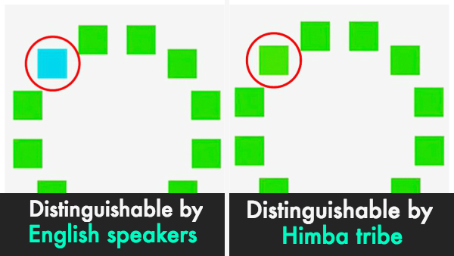
Colour is subjective

Slide 32
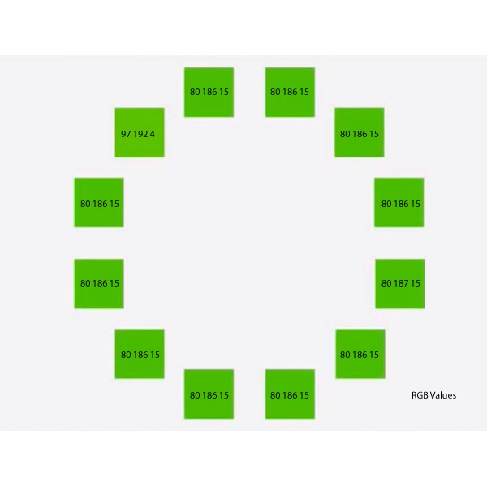
Colour is subjective

Slide 33

Colour has perceptual boundaries

Slide 34
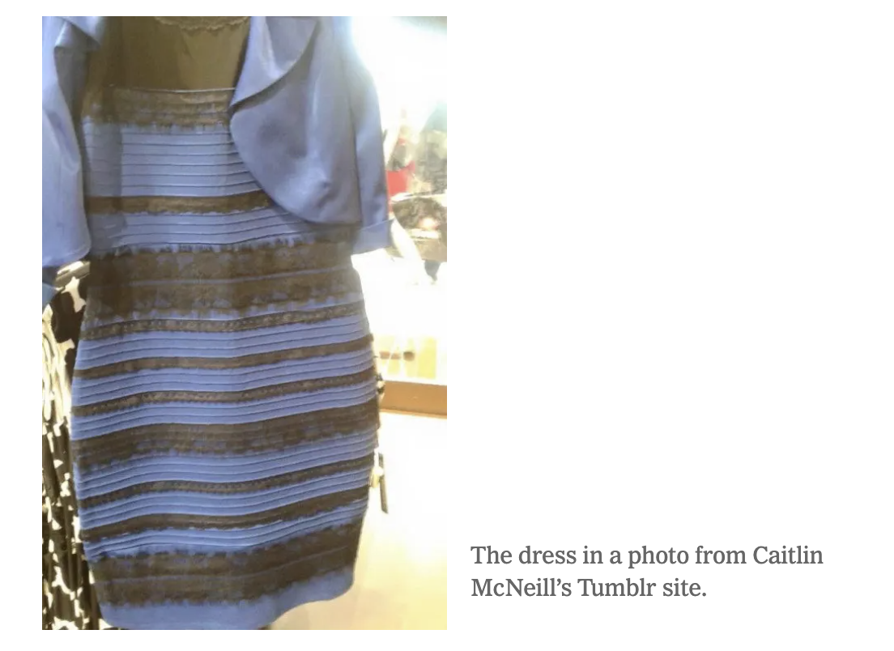
Remember that dress ?

Slide 35
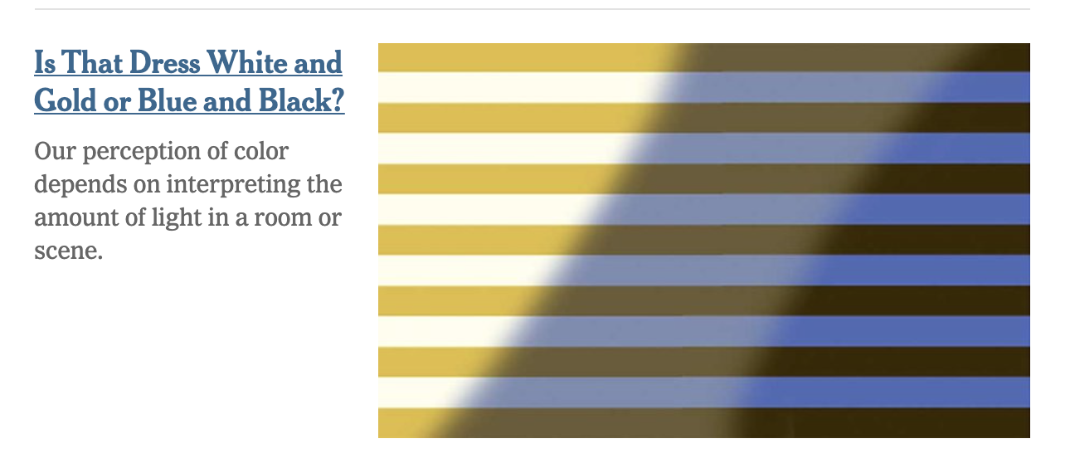
Remember that dress ?

Slide 36
Task 3 - brand+colour+psych
Take the brand colour quiz - do you know brands by their colour?
Find out how sensitive to colour you personally are
Complete the colour psychology worksheet

Slide 37
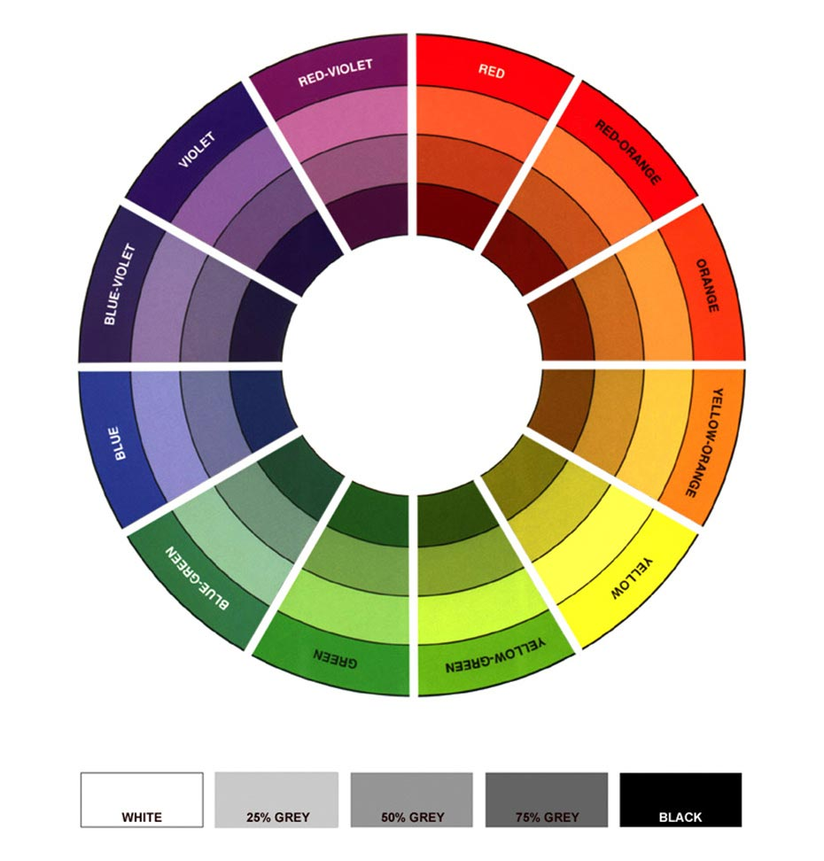
Choosing complementary colours

Slide 38
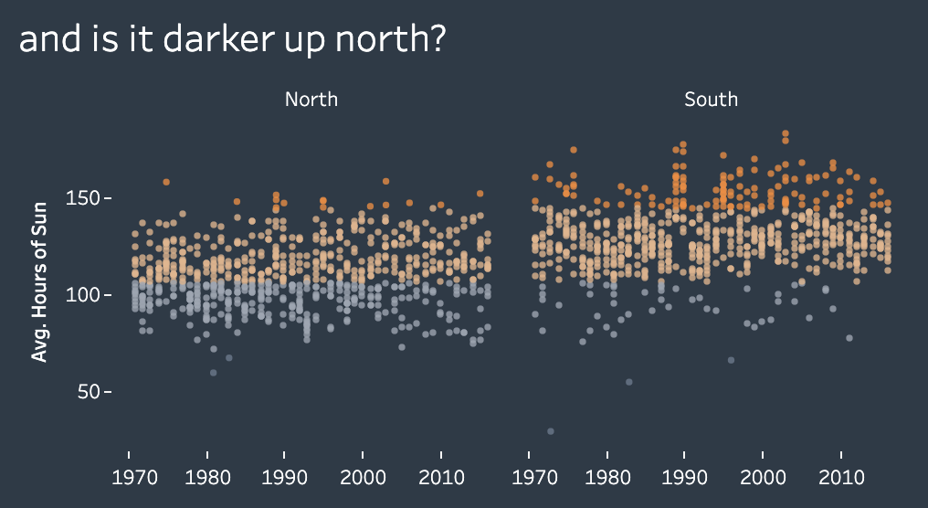
Using intuitive (/meaningful) colours

Slide 39
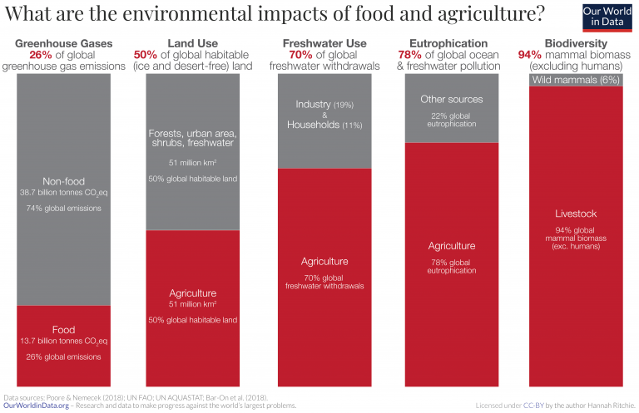
Consistent contrasting colours

Slide 40
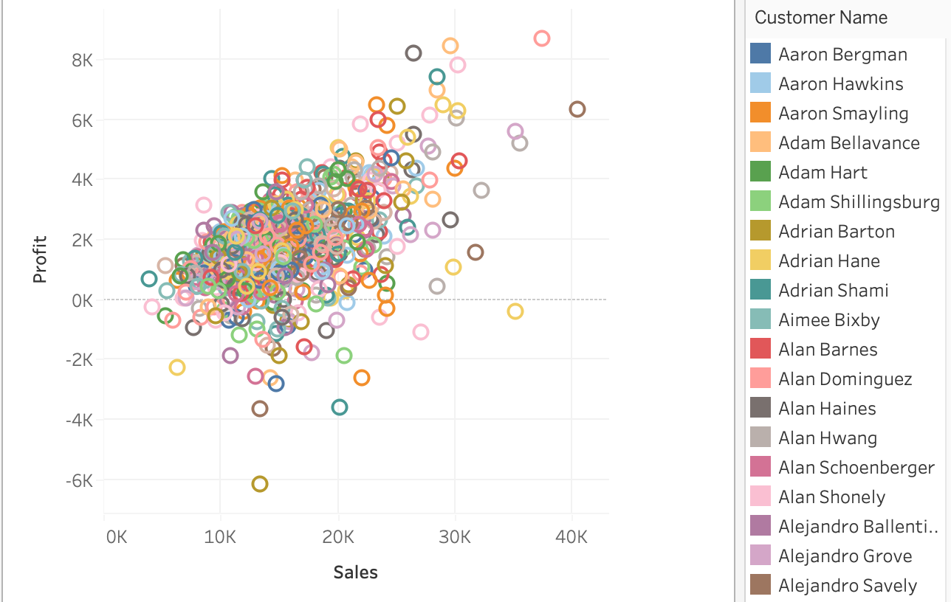
Avoid inadvertent colour associations

Slide 41
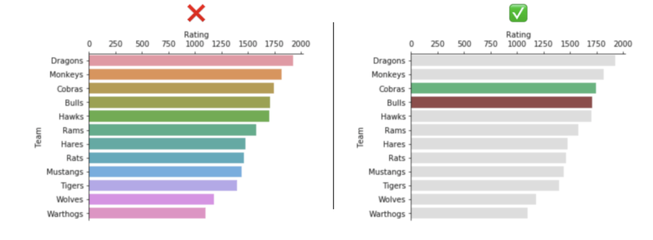
Less can mean more

Slide 42
#8 - ditch the chart junk
Boost your data to ink ratio - more data, less pointless ink

Slide 43
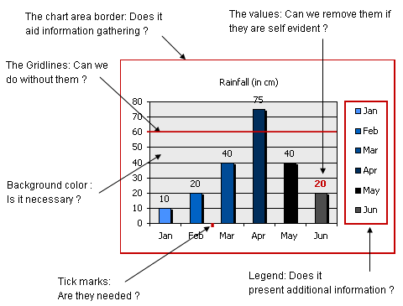
ditch the chart junk- steps
Redundant text
Sensible axis labels
Background noise

Slide 44
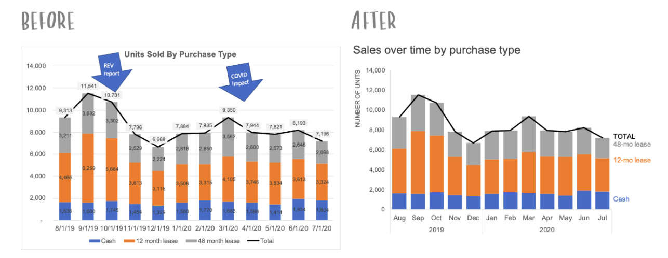
https://www.storytellingwithdata.com

Slide 45
#9 - remember your audience
Never forget the question is for target audience, their context and their prior experience with the UI.
Tailor the data product as needed to match the users needs.

Slide 46
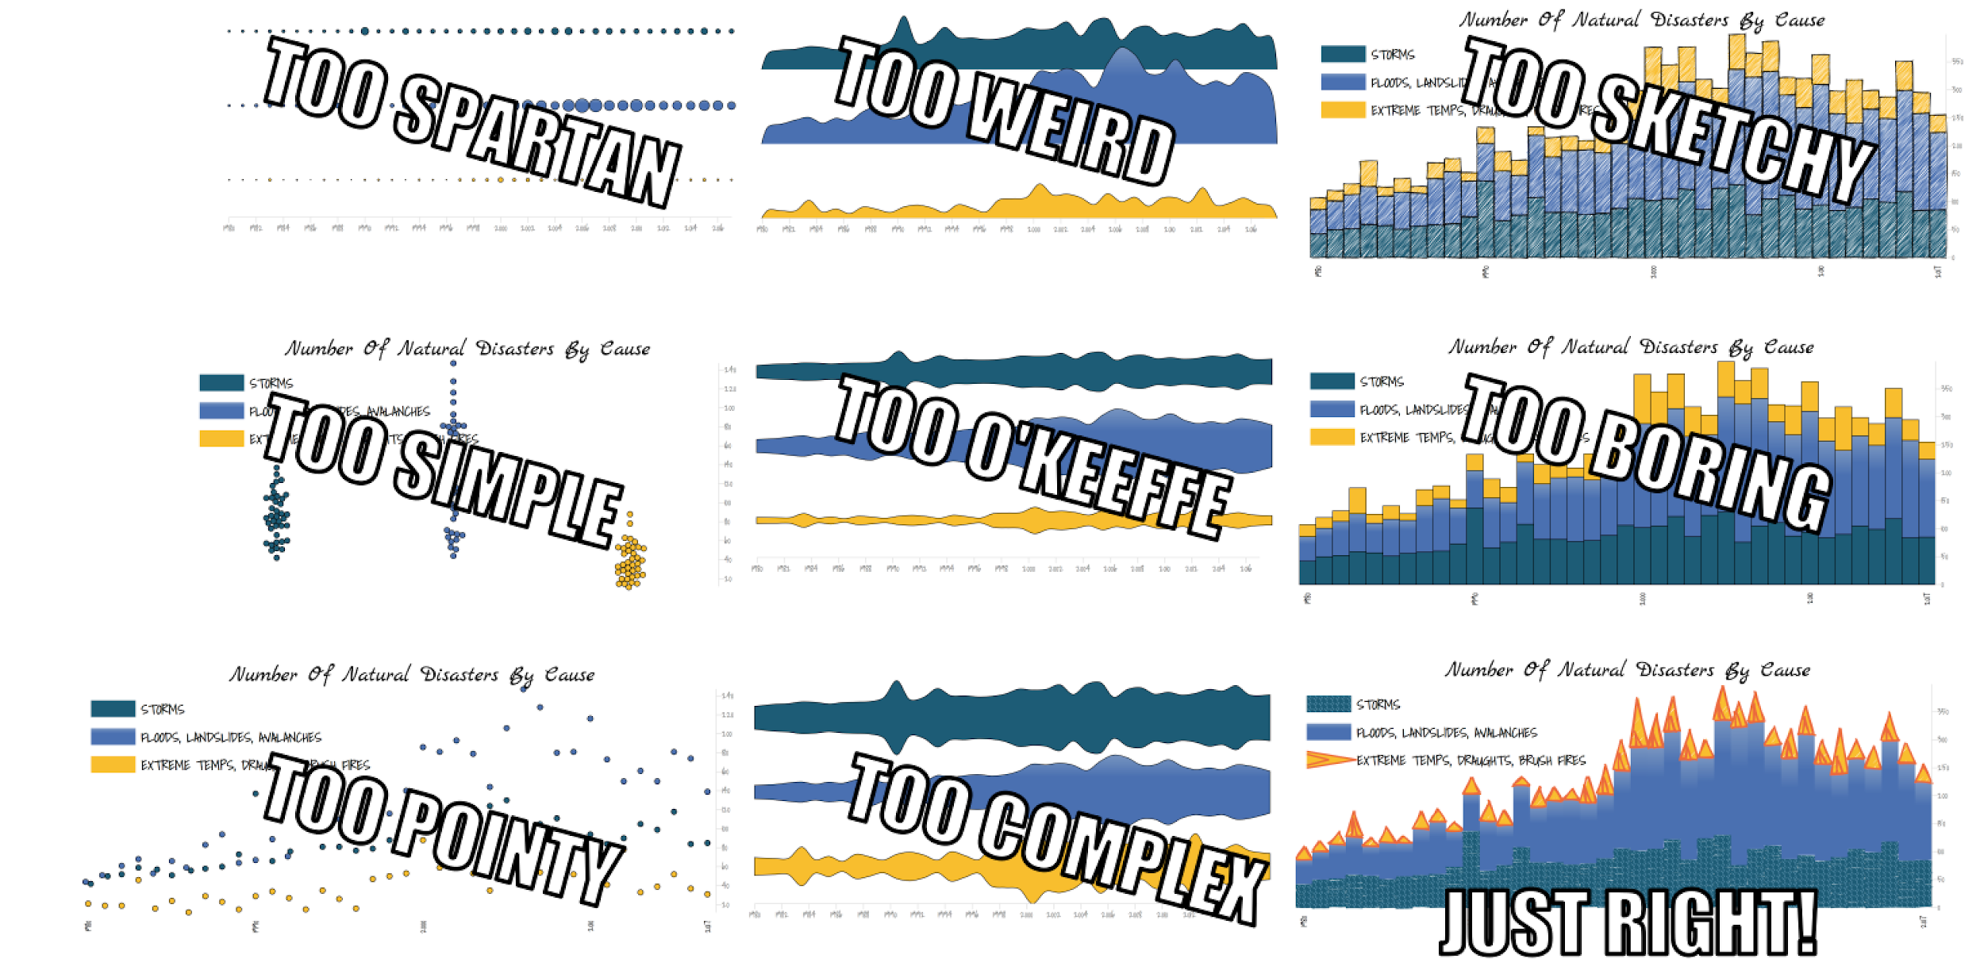
Unfortunately everyone is goldilocks

Slide 47
Task 4 - great (news) data vizzing
See if you can find a really bad or good example for yourself of visual best practices with data in the news coverage of your country / city

Slide 48
#10 - keep it relevant
A report that’s out of date is the definition of chart junk

Slide 49


Slide 50

#11 - exceptions to every rule
Sometimes breaking a best practice principle can help you communicate the data story more effectively

Slide 51
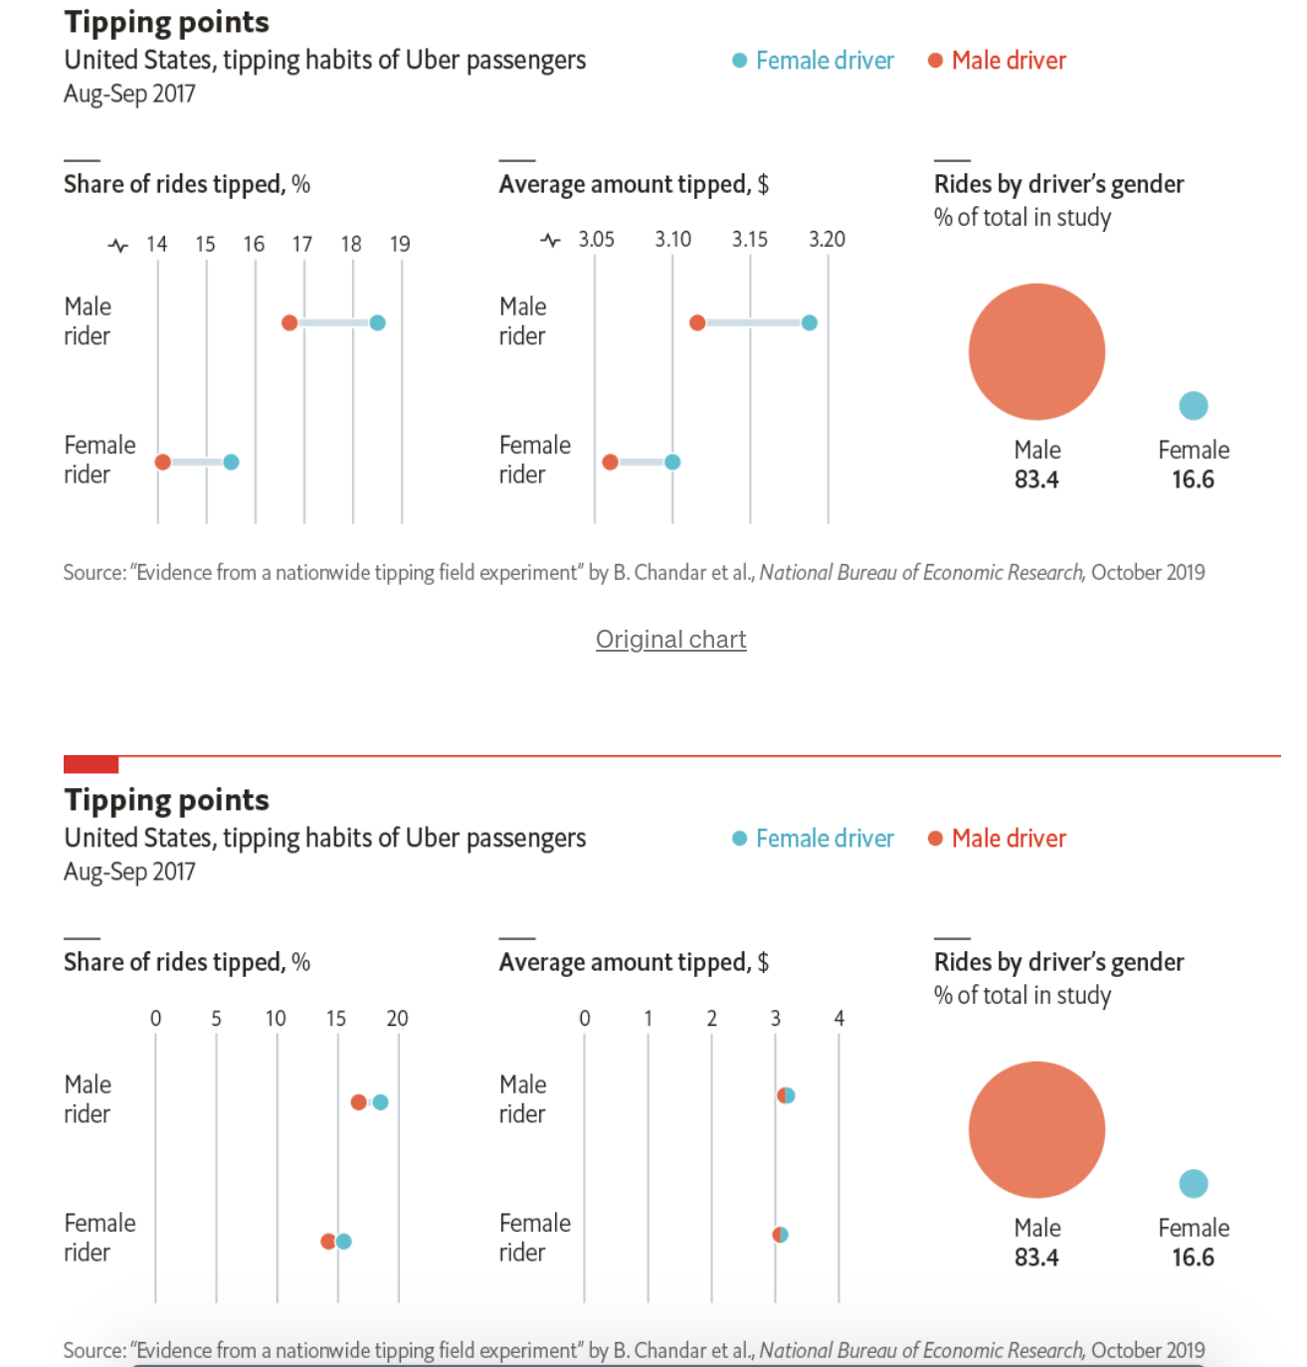
“ Don’t break the y-axis scale
The Economist occasionally gets complaints from readers about charts where the numerical axis doesn’t start at zero. It’s no wonder they are treated with suspicion. A truncated axis can cause small differences to appear larger, or make a rise or fall look more dramatic. “

Slide 52
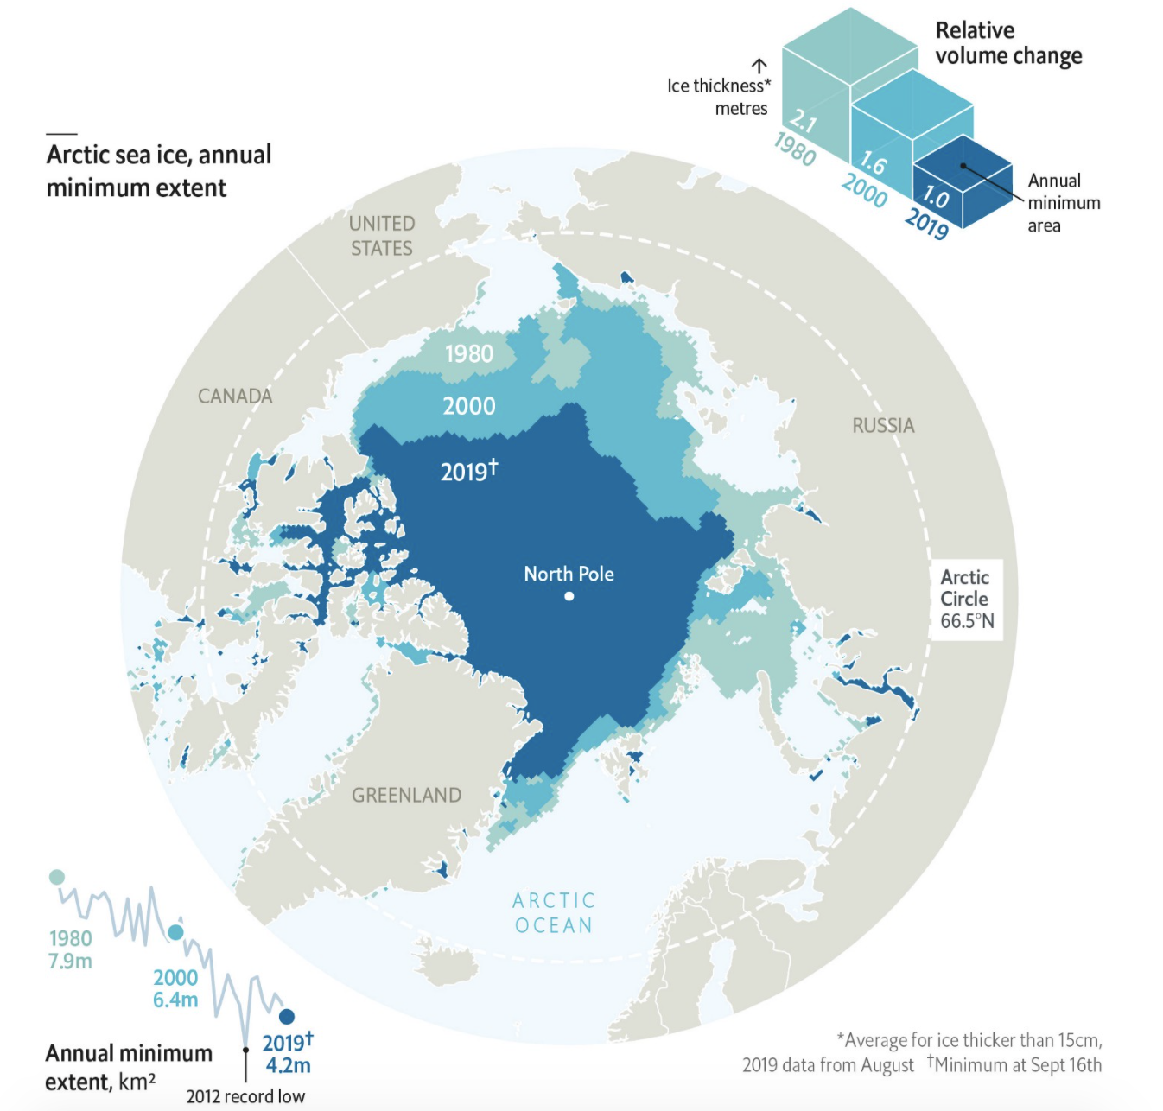
“ Don’t go 3D…
Ever since Microsoft Excel launched a thousand 3D pie charts into business meetings, 3D charts have been among the most vilified of data visualisations. There are two types of 3D visualisations: ones where the third dimension is used to depict a third variable, and others where it is purely cosmetic. Decorative 3D is particularly frowned upon as it needlessly distorts the data in multiple ways ”

Slide 53
LAB - data story makeover
Required : mid bootcamp viz or makeovermonday
Optional : Using this data set about the cost of mobile data globally, plot a single chart, applying visual best practices.
Your audience - readers of The Economist

Slide 54
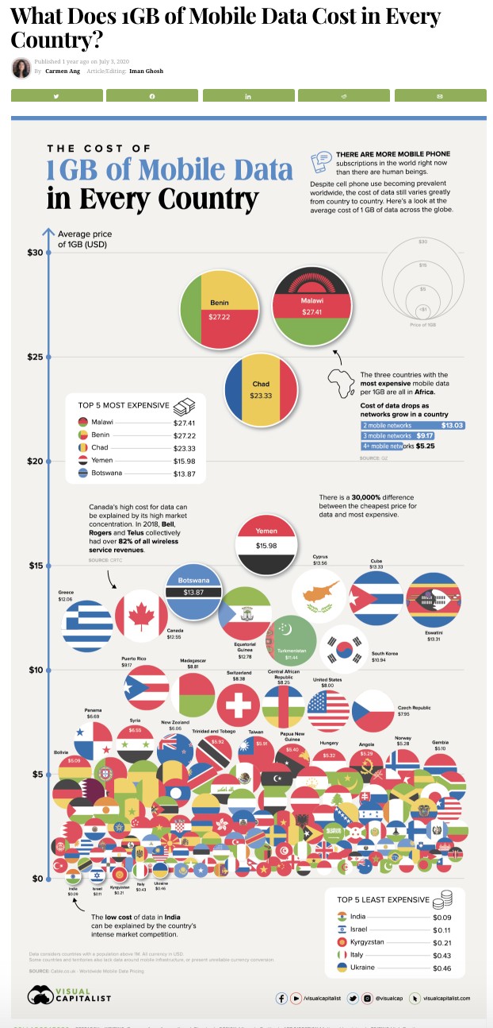
Original visualisation :

